Slide 1
Introduction to Quantum Algorithms
CS.49900 (Spring 2026)
Basics of quantum computing:
Single qubit and applications

Slide 2
Administration
Grade: A-F
To participate the presentations, sends an email until March 19th
Will have a meeting for the participants in March 24th (after the class)
Up to 4 groups
20-30 min (or shorter)
Topics
It would be best if you can choose one
Otherwise I may give some
I gave up to make a new syllabus…

Slide 3







Last time: Reversible computing
In definition, the reversible computing in dimension d is specified by:
A d-dim state can be written by $|x⟩$ for $x=0,…,d−1$ n-bit $|x⟩$ for $x∈{\left\{0,1\right\}}^{n}$
A transformation is a permutation on $\{0,…,d−1\}$
In theory, it is good enough… but it is hard to describe and implement
$$\left|x_{1}\right\rangle$$
$$\left|x_{2}\right\rangle$$
$$\left|x_{3}\right\rangle$$
$$R$$
…
…
$$\left|x_{n−1}\right\rangle$$
$$\left|x_{n}\right\rangle$$

Slide 4













Last time: Reversible computing
In practice, we want to use a small number of “basis” gates (e.g., CNOT, X, …) to implement our interested transformations (to implement “efficient” transformation)
Circuit descriptions (useful for most understanding and for implementation)
Linear algebraic description (mathematically precise and useful)
$$R$$
$$\left|x_{1}\right\rangle$$
$$\left|x_{1}\right\rangle$$
$$\left|x_{2}\right\rangle$$
$$\left|x_{2}\right\rangle$$
$$\left|x_{3}\right\rangle$$
$$R$$
$$\left|x_{3}\right\rangle$$
$$=$$
…
…
…
…
$$\left|x_{n−1}\right\rangle$$
$$\left|x_{n−1}\right\rangle$$
$$\left|x_{n}\right\rangle$$
$$\left|x_{n}\right\rangle$$

Slide 5

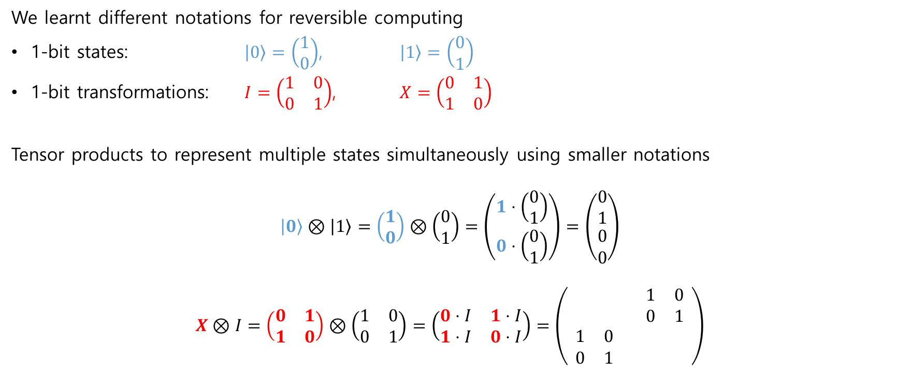
Last time: Reversible computing
We learnt different notations for reversible computing
1-bit states: $\left|0\right\rangle =\left(\begin{aligned}1 \\ 0\end{aligned}\right)$, $\left|1\right\rangle =\left(\begin{aligned}0 \\ 1\end{aligned}\right)$
1-bit transformations: $I=\left(\begin{matrix}1 & 0 \\ 0 & 1\end{matrix}\right)$, $X=\left(\begin{matrix}0 & 1 \\ 1 & 0\end{matrix}\right)$
Tensor products to represent multiple states simultaneously using smaller notations
$$\left|0\right\rangle ⊗\left|1\right\rangle =\left(\begin{aligned}1 \\ 0\end{aligned}\right)⊗\left(\begin{aligned}0 \\ 1\end{aligned}\right)=\left(\begin{aligned}1⋅\left(\begin{aligned}0 \\ 1\end{aligned}\right) \\ 0⋅\left(\begin{aligned}0 \\ 1\end{aligned}\right)\end{aligned}\right)=\left(\begin{matrix}0 \\ 1 \\ \begin{aligned}0 \\ 0\end{aligned}\end{matrix}\right)$$
$$X⊗I=\left(\begin{matrix}0 & 1 \\ 1 & 0\end{matrix}\right)⊗\left(\begin{matrix}1 & 0 \\ 0 & 1\end{matrix}\right)=\left(\begin{matrix}0⋅I & 1⋅I \\ 1⋅I & 0⋅I\end{matrix}\right)=\left(\begin{matrix}\begin{matrix} & \\ & \end{matrix} & \begin{matrix}1 & 0 \\ 0 & 1\end{matrix} \\ \begin{matrix}1 & 0 \\ 0 & 1\end{matrix} & \begin{matrix} & \\ & \end{matrix}\end{matrix}\right)$$
$X\left|1\right\rangle =\left(\begin{matrix}0 & 1 \\ 1 & 0\end{matrix}\right)\left(\begin{aligned}0 \\ 1\end{aligned}\right)$=$\left(\begin{aligned}1 \\ 0\end{aligned}\right)=|0⟩$
We will study tensor more later with greater details

Slide 6
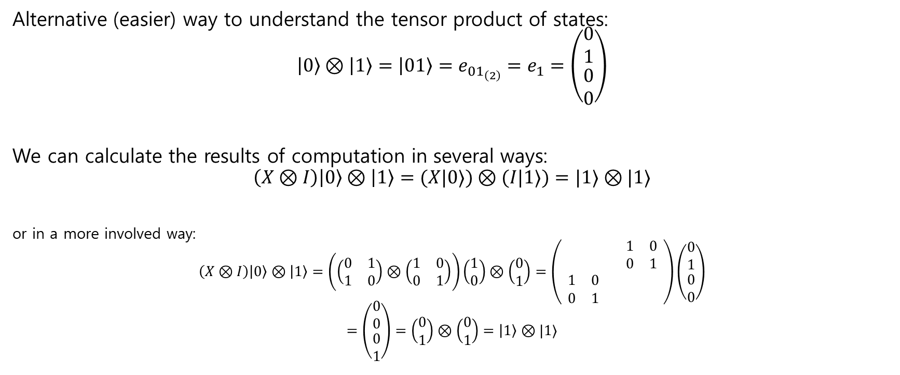
Last time: Reversible computing
Alternative (easier) way to understand the tensor product of states:
$$\left|0\right\rangle ⊗\left|1\right\rangle =\left|01\right\rangle =e_{{01}_{\left(2\right)}}=e_{1}=\left(\begin{matrix}0 \\ 1 \\ \begin{aligned}0 \\ 0\end{aligned}\end{matrix}\right)$$
We can calculate the results of computation in several ways:
$$\left(X⊗I\right)\left|0\right\rangle ⊗\left|1\right\rangle =(X|0⟩)⊗(I|1⟩)=|1⟩⊗|1⟩$$
or in a more involved way:
$$\left(X⊗I\right)\left|0\right\rangle ⊗\left|1\right\rangle =\left(\left(\begin{matrix}0 & 1 \\ 1 & 0\end{matrix}\right)⊗\left(\begin{matrix}1 & 0 \\ 0 & 1\end{matrix}\right)\right)\left(\begin{aligned}1 \\ 0\end{aligned}\right)⊗\left(\begin{aligned}0 \\ 1\end{aligned}\right)=\left(\begin{matrix}\begin{matrix} & \\ & \end{matrix} & \begin{matrix}1 & 0 \\ 0 & 1\end{matrix} \\ \begin{matrix}1 & 0 \\ 0 & 1\end{matrix} & \begin{matrix} & \\ & \end{matrix}\end{matrix}\right)\left(\begin{matrix}0 \\ 1 \\ \begin{aligned}0 \\ 0\end{aligned}\end{matrix}\right)$$
$$=\left(\begin{matrix}0 \\ 0 \\ \begin{aligned}0 \\ 1\end{aligned}\end{matrix}\right)=\left(\begin{aligned}0 \\ 1\end{aligned}\right)⊗\left(\begin{aligned}0 \\ 1\end{aligned}\right)=\left|1\right\rangle ⊗|1⟩$$

Slide 7








Last time: Reversible computing
A more complicated example:
$$\left(CNOT⊗I\right)\left|101\right\rangle =(CNOT⊗I)\left|10⟩⊗|1\right\rangle =(CNOT|10⟩)⊗(I|1⟩)=|11⟩⊗|1⟩=|111⟩$$
$$\left(\begin{matrix}0 \\ 0 \\ \begin{aligned}0 \\ 0 \\ 1 \\ 0 \\ 0 \\ 0\end{aligned}\end{matrix}\right)=e_{5}=e_{{101}_{(2)}}=\left|101\right\rangle =\left|1\right\rangle \left|0\right\rangle \left|1\right\rangle =\left|1\right\rangle ⊗\left|0\right\rangle ⊗\left|1\right\rangle$$
$$\left|1\right\rangle$$
$$\left|1\right\rangle$$
$$\left|0\right\rangle$$
$$\left|1\right\rangle$$
$$\left|1\right\rangle$$
$$\left|1\right\rangle$$

Slide 8
Today we will learn about a single-qubit
Basic of quantum computing
A single qubit
Definition (superposition)
Measurements
Quantum operations
Unitary operations
Basic 1-qubit quantum gates
Examples
Quantum random number generators and more

Slide 9
Today we will learn about a single-qubit
Basic of quantum computing
A single qubit
Definition (superposition)
Measurements
Quantum operations
Unitary operations
Basic 1-qubit quantum gates
Examples
Quantum random number generators and more

Slide 10
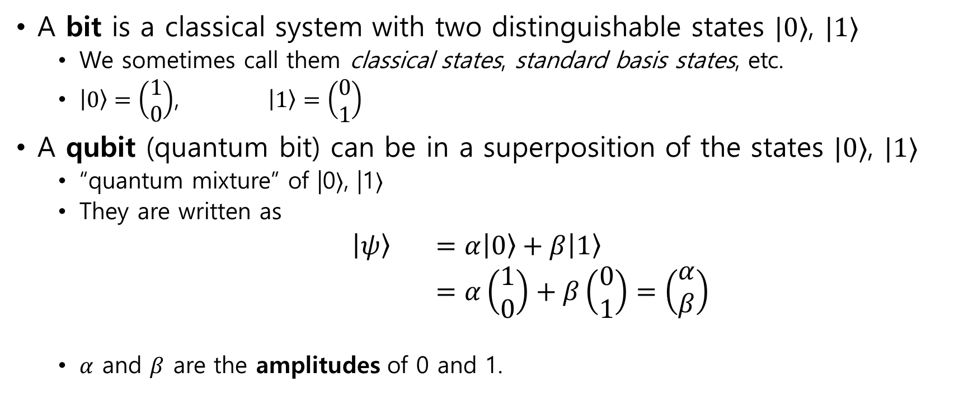
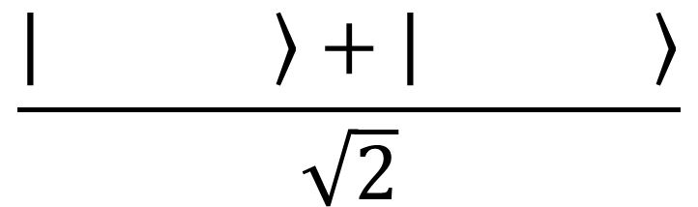
Bit vs Qubit (quantum bit)
A bit is a classical system with two distinguishable states $|0⟩$, $|1⟩$
We sometimes call them classical states, standard basis states, etc.
$\left|0\right\rangle =\left(\begin{aligned}1 \\ 0\end{aligned}\right)$, $\left|1\right\rangle =\left(\begin{aligned}0 \\ 1\end{aligned}\right)$
A qubit (quantum bit) can be in a superposition of the states $|0⟩$, $|1⟩$
“quantum mixture” of |0⟩, |1⟩
They are written as
$\left|ψ\right\rangle$ $=α\left|0\right\rangle +β\left|1\right\rangle$
$=α\left(\begin{aligned}1 \\ 0\end{aligned}\right)+β\left(\begin{aligned}0 \\ 1\end{aligned}\right)=\left(\begin{aligned}α \\ β\end{aligned}\right)$
$α$ and $β$ are the amplitudes of 0 and 1.
$$\frac{\left| \right\rangle +\left| \right\rangle }{\sqrt{2}}$$
Notes:
To answer this, we really have to dig into the physics of how information is processed. Think about how information is stored on your hard drive, say. Ok, hard drives aren’t made like this anymore, but at some point they were stacks of discs and the data is stored via the orientation of magnetic material on disks. If the magnetization is pointing up, or down, that corresponds to 0 or 1. So when you erase or reset some information,

Slide 11
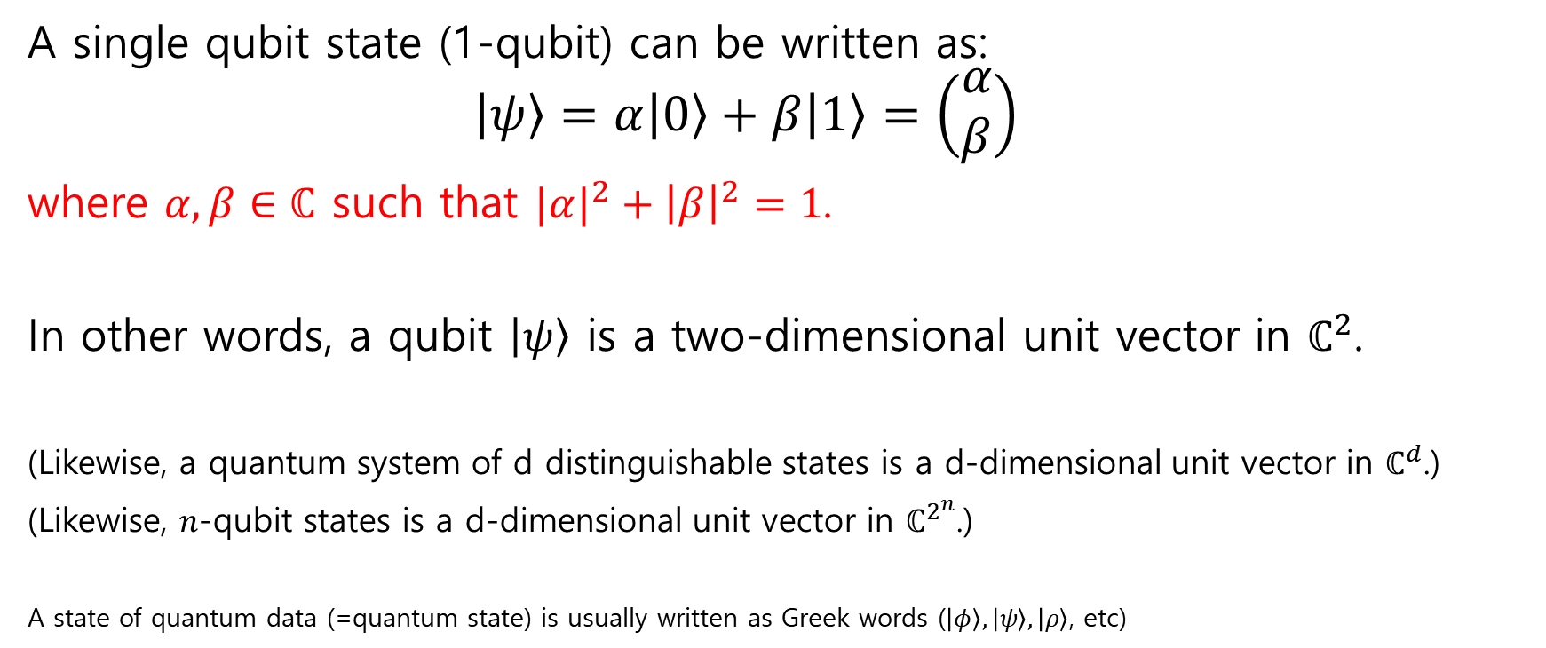
Qubit as a unit vector
A single qubit state (1-qubit) can be written as:
$$\left|ψ\right\rangle =α\left|0\right\rangle +β\left|1\right\rangle =\left(\begin{aligned}α \\ β\end{aligned}\right)$$
where $α,β∈ℂ$ such that $|α|^{2}+{\left|β\right|}^{2}=1$.
In other words, a qubit $\left|ψ\right\rangle$ is a two-dimensional unit vector in $ℂ^{2}$.
(Likewise, a quantum system of d distinguishable states is a d-dimensional unit vector in $ℂ^{d}$.)
(Likewise, $n$-qubit states is a d-dimensional unit vector in $ℂ^{2^{n}}$.)
A state of quantum data (=quantum state) is usually written as Greek words ($\left|φ\right\rangle ,\left|ψ\right\rangle ,\left|ρ\right\rangle$, etc)
Notes:
To answer this, we really have to dig into the physics of how information is processed. Think about how information is stored on your hard drive, say. Ok, hard drives aren’t made like this anymore, but at some point they were stacks of discs and the data is stored via the orientation of magnetic material on disks. If the magnetization is pointing up, or down, that corresponds to 0 or 1. So when you erase or reset some information,

Slide 12

Examples
Check on board
Classical states
$\left|0\right\rangle =\left(\begin{aligned}1 \\ 0\end{aligned}\right)$ and $\left|1\right\rangle =\left(\begin{aligned}0 \\ 1\end{aligned}\right)$
Notes:
To answer this, we really have to dig into the physics of how information is processed. Think about how information is stored on your hard drive, say. Ok, hard drives aren’t made like this anymore, but at some point they were stacks of discs and the data is stored via the orientation of magnetic material on disks. If the magnetization is pointing up, or down, that corresponds to 0 or 1. So when you erase or reset some information,

Slide 13

Examples
Check on board
Uniform superpositions
$$\left|+\right\rangle =\frac{1}{\sqrt{2}}\left|0\right\rangle +\frac{1}{\sqrt{2}}\left|1\right\rangle =\frac{1}{\sqrt{2}}\left(\begin{aligned}1 \\ 1\end{aligned}\right)=\left(\begin{aligned}1/\sqrt{2} \\ 1/\sqrt{2}\end{aligned}\right)$$
$$\left|−\right\rangle =\frac{1}{\sqrt{2}}\left|0\right\rangle −\frac{1}{\sqrt{2}}\left|1\right\rangle =\frac{1}{\sqrt{2}}\left(\begin{aligned}1 \\ −1\end{aligned}\right)=\left(\begin{aligned}1/\sqrt{2} \\ −1/\sqrt{2}\end{aligned}\right)$$
Notes:
To answer this, we really have to dig into the physics of how information is processed. Think about how information is stored on your hard drive, say. Ok, hard drives aren’t made like this anymore, but at some point they were stacks of discs and the data is stored via the orientation of magnetic material on disks. If the magnetization is pointing up, or down, that corresponds to 0 or 1. So when you erase or reset some information,

Slide 14

Examples
Check on board
Another example
$$\left|φ\right\rangle =\frac{i}{\sqrt{3}}\left|0\right\rangle +\sqrt{\frac{2}{3}}\left|1\right\rangle =\left(\begin{aligned}i/√3 \\ \sqrt{2}/\sqrt{3}\end{aligned}\right)$$
Non-valid example
$$i\left|0\right\rangle −\frac{1}{2}\left|1\right\rangle$$
Notes:
To answer this, we really have to dig into the physics of how information is processed. Think about how information is stored on your hard drive, say. Ok, hard drives aren’t made like this anymore, but at some point they were stacks of discs and the data is stored via the orientation of magnetic material on disks. If the magnetization is pointing up, or down, that corresponds to 0 or 1. So when you erase or reset some information,

Slide 15
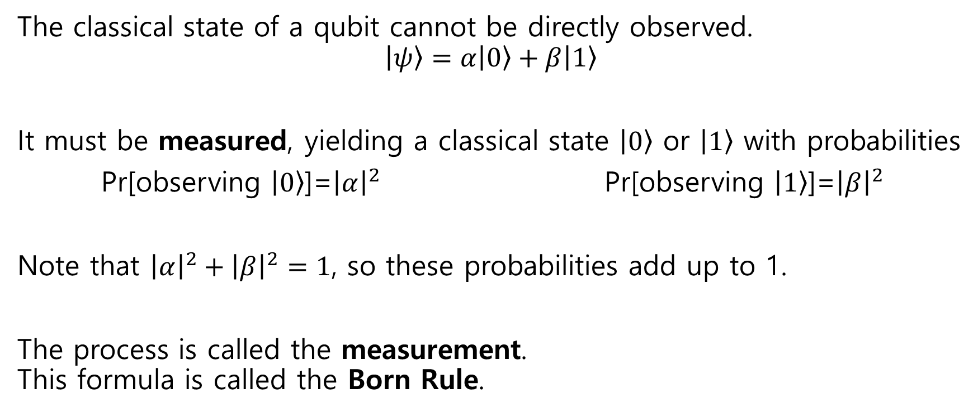
The first operation: Observing qubits
The classical state of a qubit cannot be directly observed.
$$\left|ψ\right\rangle =α\left|0\right\rangle +β\left|1\right\rangle$$
It must be measured, yielding a classical state $\left|0\right\rangle$ or $\left|1\right\rangle$ with probabilities
Pr[observing $\left|0\right\rangle$]=${\left|α\right|}^{2}$ Pr[observing $\left|1\right\rangle$]=${\left|β\right|}^{2}$
Note that ${\left|α\right|}^{2}+{\left|β\right|}^{2}=1$, so these probabilities add up to 1.
The process is called the measurement. This formula is called the Born Rule.
Notes:
To answer this, we really have to dig into the physics of how information is processed. Think about how information is stored on your hard drive, say. Ok, hard drives aren’t made like this anymore, but at some point they were stacks of discs and the data is stored via the orientation of magnetic material on disks. If the magnetization is pointing up, or down, that corresponds to 0 or 1. So when you erase or reset some information,

Slide 16

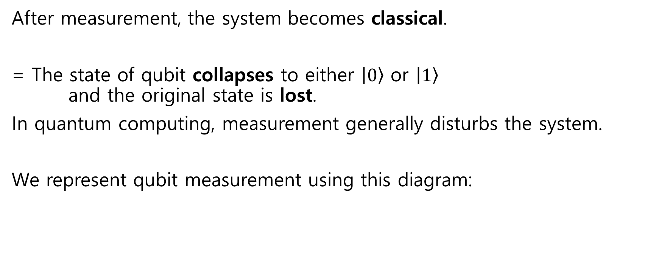

The first operation: Observing qubits
After measurement, the system becomes classical.
= The state of qubit collapses to either $\left|0\right\rangle$ or $\left|1\right\rangle$ and the original state is lost.
In quantum computing, measurement generally disturbs the system.
We represent qubit measurement using this diagram:
$$\left|ψ\right\rangle$$
Notes:
To answer this, we really have to dig into the physics of how information is processed. Think about how information is stored on your hard drive, say. Ok, hard drives aren’t made like this anymore, but at some point they were stacks of discs and the data is stored via the orientation of magnetic material on disks. If the magnetization is pointing up, or down, that corresponds to 0 or 1. So when you erase or reset some information,

Slide 17




Examples
Check on board
Classical states
$\left|0\right\rangle =\left(\begin{aligned}1 \\ 0\end{aligned}\right)$ and $\left|1\right\rangle =\left(\begin{aligned}0 \\ 1\end{aligned}\right)$
$$\left|0\right\rangle$$
$$\left|0\right\rangle$$
$$\left|1\right\rangle$$
$$\left|1\right\rangle$$
Notes:
To answer this, we really have to dig into the physics of how information is processed. Think about how information is stored on your hard drive, say. Ok, hard drives aren’t made like this anymore, but at some point they were stacks of discs and the data is stored via the orientation of magnetic material on disks. If the magnetization is pointing up, or down, that corresponds to 0 or 1. So when you erase or reset some information,

Slide 18
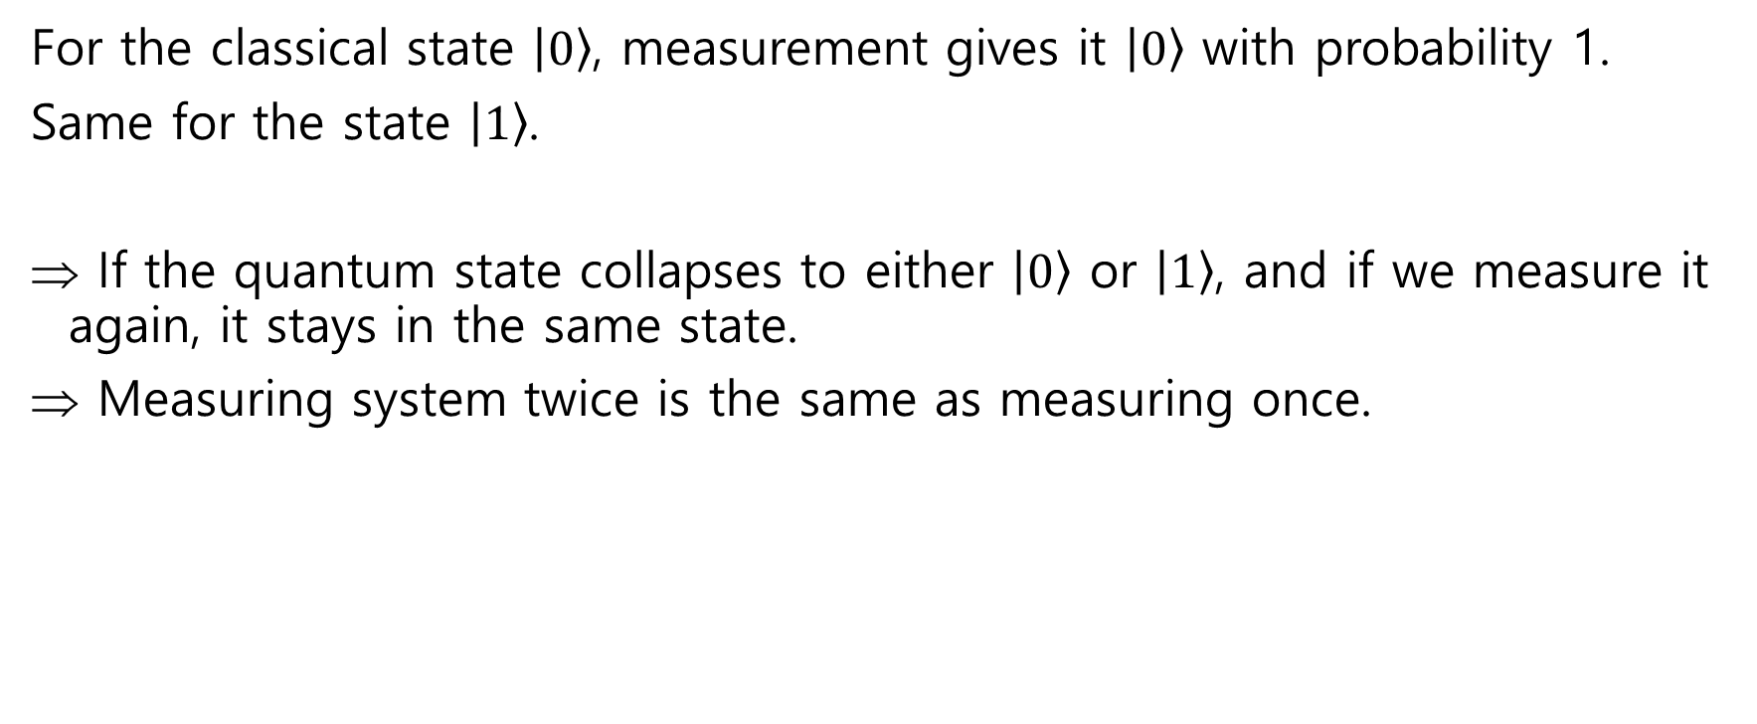



The first operation: Observing qubits
For the classical state $\left|0\right\rangle$, measurement gives it $\left|0\right\rangle$ with probability 1.
Same for the state $\left|1\right\rangle$.
If the quantum state collapses to either $\left|0\right\rangle$ or $\left|1\right\rangle$, and if we measure it again, it stays in the same state.
Measuring system twice is the same as measuring once.
$$\left|ψ\right\rangle$$
$$=$$
$$\left|ψ\right\rangle$$
Notes:
To answer this, we really have to dig into the physics of how information is processed. Think about how information is stored on your hard drive, say. Ok, hard drives aren’t made like this anymore, but at some point they were stacks of discs and the data is stored via the orientation of magnetic material on disks. If the magnetization is pointing up, or down, that corresponds to 0 or 1. So when you erase or reset some information,

Slide 19




Examples
Check on board
Uniform superpositions
$$\left|+\right\rangle =\frac{1}{\sqrt{2}}\left|0\right\rangle +\frac{1}{\sqrt{2}}\left|1\right\rangle =\frac{1}{\sqrt{2}}\left(\begin{aligned}1 \\ 1\end{aligned}\right)=\left(\begin{aligned}1/\sqrt{2} \\ 1/\sqrt{2}\end{aligned}\right)$$
$$\left|−\right\rangle =\frac{1}{\sqrt{2}}\left|0\right\rangle −\frac{1}{\sqrt{2}}\left|1\right\rangle =\frac{1}{\sqrt{2}}\left(\begin{aligned}1 \\ −1\end{aligned}\right)=\left(\begin{aligned}1/\sqrt{2} \\ −1/\sqrt{2}\end{aligned}\right)$$
$$\left|+\right\rangle$$
$$\left|b\right\rangle$$
$$\left|−\right\rangle$$
$$\left|b′\right\rangle$$
Notes:
To answer this, we really have to dig into the physics of how information is processed. Think about how information is stored on your hard drive, say. Ok, hard drives aren’t made like this anymore, but at some point they were stacks of discs and the data is stored via the orientation of magnetic material on disks. If the magnetization is pointing up, or down, that corresponds to 0 or 1. So when you erase or reset some information,

Slide 20

Examples
Check on board
Another example
$$\left|φ\right\rangle =\frac{i}{\sqrt{3}}\left|0\right\rangle +\sqrt{\frac{2}{3}}\left|1\right\rangle =\left(\begin{aligned}i/√3 \\ \sqrt{2}/\sqrt{3}\end{aligned}\right)$$
Non-valid example
$$i\left|0\right\rangle −\frac{1}{2}\left|1\right\rangle$$
$$\left|φ\right\rangle$$
Notes:
To answer this, we really have to dig into the physics of how information is processed. Think about how information is stored on your hard drive, say. Ok, hard drives aren’t made like this anymore, but at some point they were stacks of discs and the data is stored via the orientation of magnetic material on disks. If the magnetization is pointing up, or down, that corresponds to 0 or 1. So when you erase or reset some information,

Slide 21
Today we will learn about a single-qubit
Basic of quantum computing
A single qubit
Definition (superposition)
Measurements
Quantum operations
Unitary operations
Basic 1-qubit quantum gates
Examples
Quantum random number generators and more

Slide 22

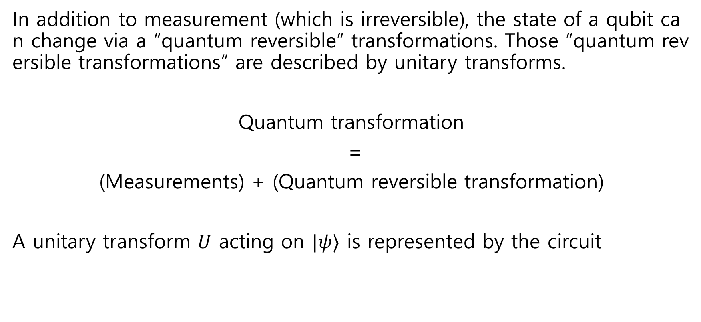

Second: “Reversible” Transformations
In addition to measurement (which is irreversible), the state of a qubit can change via a “quantum reversible” transformations. Those “quantum reversible transformations” are described by unitary transforms.
Quantum transformation
=
(Measurements) + (Quantum reversible transformation)
A unitary transform $U$ acting on $|ψ⟩$ is represented by the circuit
$$\left|ψ\right\rangle$$
$$U$$

Slide 23
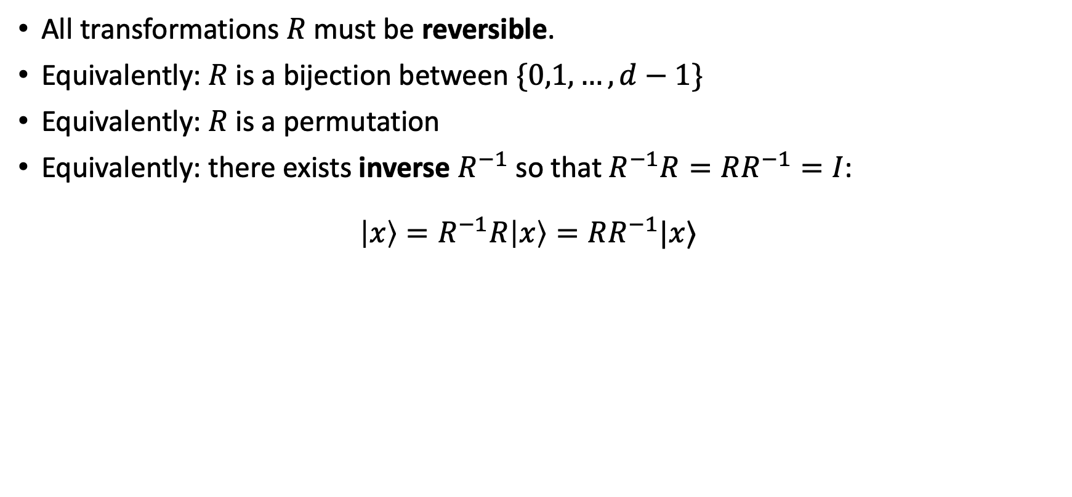
Recall the slide from reversible computing
All transformations $R$must be reversible.
Equivalently: $R$ is a bijection between $\{0,1,…,d−1\}$
Equivalently: $R$ is a permutation
Equivalently: there exists inverse $R^{−1}$ so that $R^{−1}R=RR^{−1}=I$: $\left|x\right\rangle =R^{−1}R\left|x\right\rangle =RR^{−1}|x⟩$

Slide 24
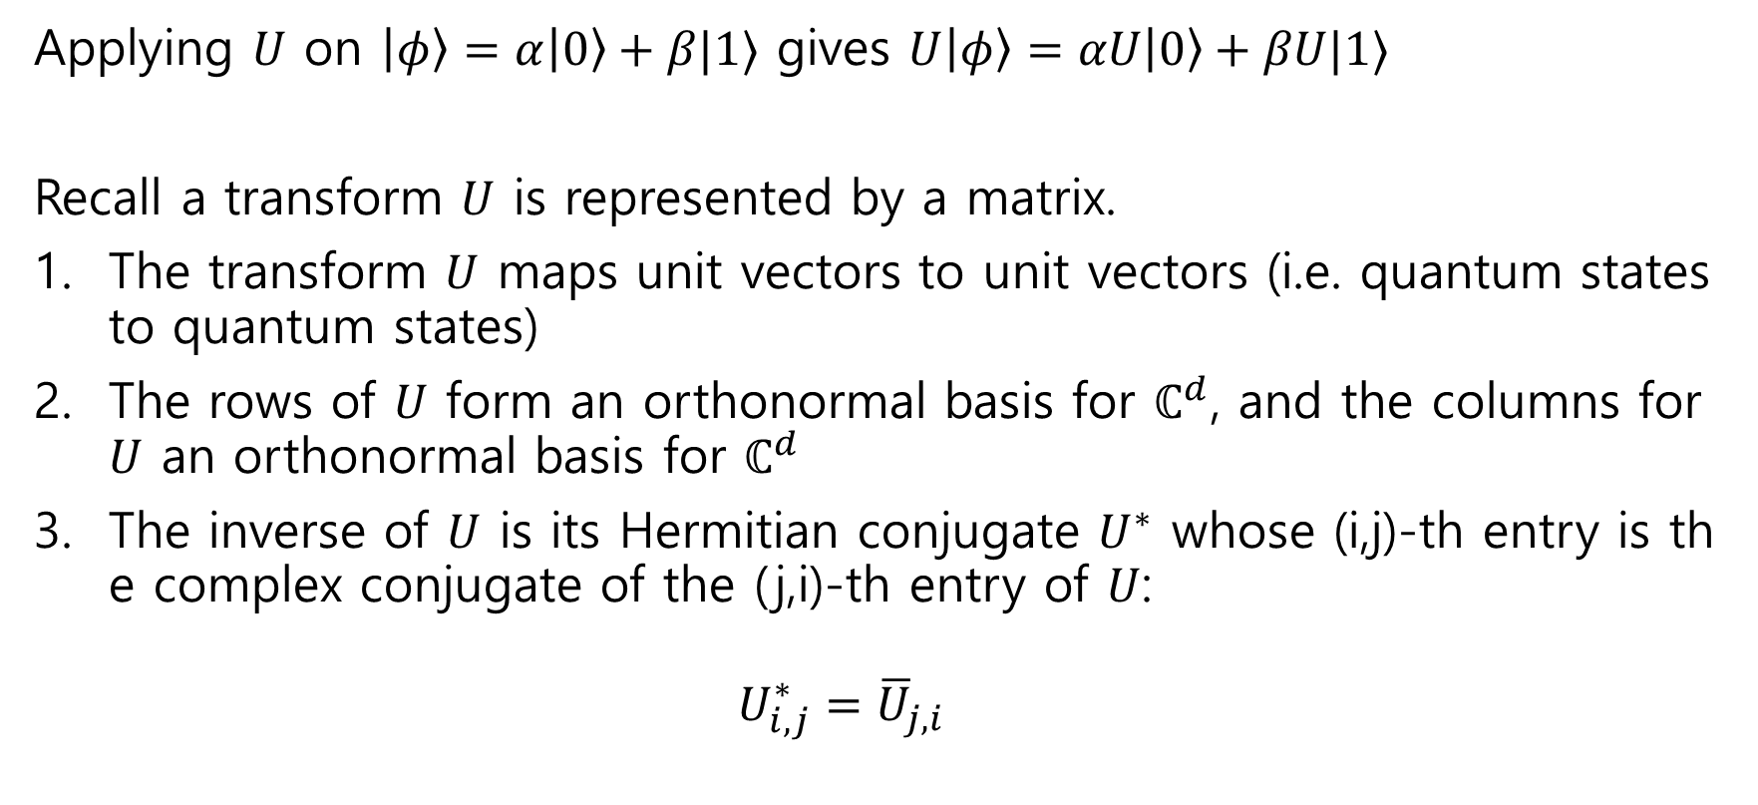
Equivalent definitions of unitary transform (proving equivalence is )
Slightly advanced
Will see the examples
Applying $U$ on $\left|φ\right\rangle =α\left|0\right\rangle +β|1⟩$ gives $U\left|φ\right\rangle =αU\left|0\right\rangle +βU|1⟩$
Recall a transform $U$ is represented by a matrix.
The transform $U$ maps unit vectors to unit vectors (i.e. quantum states to quantum states)
The rows of $U$ form an orthonormal basis for $ℂ^{d}$, and the columns for $U$ an orthonormal basis for $ℂ^{d}$
The inverse of $U$ is its Hermitian conjugate $U^{∗}$ whose (i,j)-th entry is the complex conjugate of the (j,i)-th entry of $U$:
$$U_{i,j}^{∗}={\overline{U}}_{j,i}$$
This is the definitions of “unitary matrices”

Slide 25








Examples of qubit unitary transforms (=quantum gates)
We will use small unitary matrices in the circuit synthesis.
Identity matrix $I=\left(\begin{matrix}1 & 0 \\ 0 & 1\end{matrix}\right)$
For all qubit states $|ψ⟩$, $I\left|ψ\right\rangle =\left|ψ\right\rangle$.
$$\left|ψ\right\rangle$$
$$I$$
$$\left|ψ\right\rangle$$
$$\left|ψ\right\rangle$$
$$I$$
$$=$$
$$\left|ψ\right\rangle$$

Slide 26

Examples of qubit unitary transforms (=quantum gates)
Bit flit matrix $X=\left(\begin{matrix}0 & 1 \\ 1 & 0\end{matrix}\right)$
$X\left|0\right\rangle =|1⟩$ $X\left|1\right\rangle =|0⟩$
$$X(α\left|0\right\rangle +β|1⟩)=αX|0⟩+βX|1⟩=α|1⟩+β|0⟩$$
These are a “qubit” extension of classical transformations.

Slide 27

Examples of qubit unitary transforms (=quantum gates)
Phase flip matrix $Z=\left(\begin{matrix}1 & 0 \\ 0 & −1\end{matrix}\right)$
$Z\left|0\right\rangle =|0⟩$ $Z\left|1\right\rangle =−|1⟩$
$$Z(α\left|0\right\rangle +β|1⟩)=α|0⟩−β|1⟩$$

Slide 28

Examples of qubit unitary transforms (=quantum gates)
Hadamard matrix $H=\frac{1}{\sqrt{2}}\left(\begin{matrix}1 & 1 \\ 1 & −1\end{matrix}\right)$
$H\left|0\right\rangle =$ ( do on board )
$H\left|1\right\rangle =$ ( do on board )
$H$ maps classical states $|0⟩$ and $|1⟩$ into quantum superpositions.

Slide 29
Today we will learn about a single-qubit
Basic of quantum computing
A single qubit
Definition (superposition)
Measurements
Quantum operations
Unitary operations
Basic 1-qubit quantum gates
Examples
Quantum random number generators and more

Slide 30
Examples
Quantum random number generators
Example about phases
Example about a single intermediate measurement
Example about many measurements

Slide 31
Quantum random number generations
Classically, randomness is hard to get
Use temperature, price of stock, time, rand(), …
Use cryptographic pseudorandomness, …
They are not (at least hard to prove) perfect randomness.
On the other hand, quantum physics is random by definition.
advanced
Notes:
To answer this, we really have to dig into the physics of how information is processed. Think about how information is stored on your hard drive, say. Ok, hard drives aren’t made like this anymore, but at some point they were stacks of discs and the data is stored via the orientation of magnetic material on disks. If the magnetization is pointing up, or down, that corresponds to 0 or 1. So when you erase or reset some information,

Slide 32
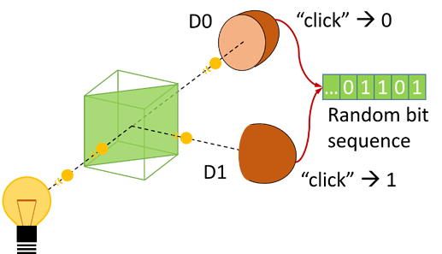


Quantum random number generations
Apply Hadamard transform on a classical state.
It is easy to implement (beam splitter)!
… the ONLY easy-to-implement application.
$$\left|0\right\rangle$$
$$H$$
Notes:
To answer this, we really have to dig into the physics of how information is processed. Think about how information is stored on your hard drive, say. Ok, hard drives aren’t made like this anymore, but at some point they were stacks of discs and the data is stored via the orientation of magnetic material on disks. If the magnetization is pointing up, or down, that corresponds to 0 or 1. So when you erase or reset some information,

Slide 33
Examples
Quantum random number generators
Example about phases
Example about a single intermediate measurement
Example about many measurements

Slide 34

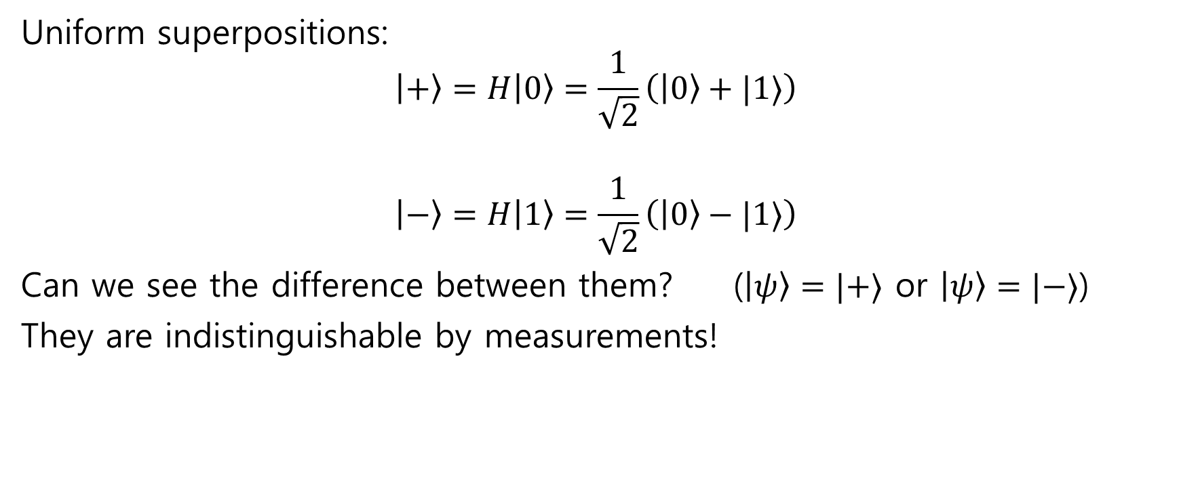


Uniform superpositions
$$\left|0\right\rangle$$
$$H$$
$$\left|1\right\rangle$$
$$H$$
Uniform superpositions:
$$\left|+\right\rangle =H\left|0\right\rangle =\frac{1}{\sqrt{2}}\left(\left|0\right\rangle +|1⟩\right)$$
$$\left|−\right\rangle =H\left|1\right\rangle =\frac{1}{\sqrt{2}}\left(\left|0\right\rangle −|1⟩\right)$$
Can we see the difference between them? ($\left|ψ\right\rangle =|+⟩$ or $\left|ψ\right\rangle =|−⟩$)
They are indistinguishable by measurements!
$$\left|ψ\right\rangle$$
Notes:
To answer this, we really have to dig into the physics of how information is processed. Think about how information is stored on your hard drive, say. Ok, hard drives aren’t made like this anymore, but at some point they were stacks of discs and the data is stored via the orientation of magnetic material on disks. If the magnetization is pointing up, or down, that corresponds to 0 or 1. So when you erase or reset some information,

Slide 35



Uniform superpositions
Solution: Apply $H$ before measuring!
$H\left|+\right\rangle =$ ( do on board ) $=|0⟩$
$H\left|−\right\rangle =$ ( do on board ) $=|1⟩$
$$\left|ψ\right\rangle$$
$$H$$
Notes:
To answer this, we really have to dig into the physics of how information is processed. Think about how information is stored on your hard drive, say. Ok, hard drives aren’t made like this anymore, but at some point they were stacks of discs and the data is stored via the orientation of magnetic material on disks. If the magnetization is pointing up, or down, that corresponds to 0 or 1. So when you erase or reset some information,

Slide 36
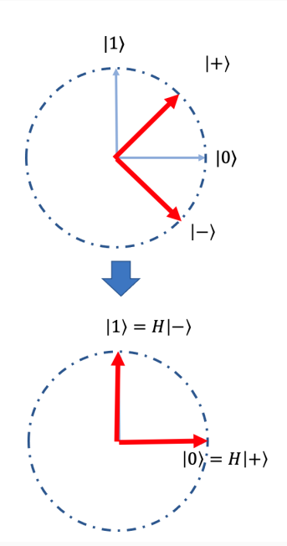


Computation example
Hadamard matrix $H=\frac{1}{\sqrt{2}}\left(\begin{matrix}1 & 1 \\ 1 & −1\end{matrix}\right)$
$H(α\left|0\right\rangle +β|1⟩)=$ ( do on board )
$H\left(\cos{θ} | 0\right\rangle +\sin{θ}|1⟩)=$ ( do on board )
( Geometry of $X$ and $Z$ and $X=HZH$ do on board )
$$\left|ψ_{θ}\right\rangle =\cos{θ}\left|0\right\rangle +\sin{θ}|1⟩$$

Slide 37
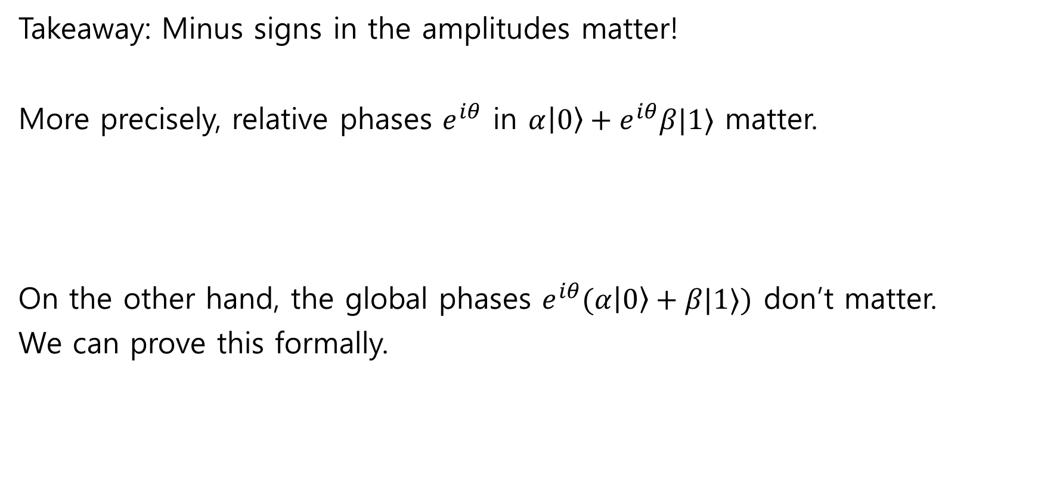
Phase matters!
Takeaway: Minus signs in the amplitudes matter!
More precisely, relative phases $e^{iθ}$ in $α\left|0\right\rangle +e^{iθ}β|1⟩$ matter.
On the other hand, the global phases $e^{iθ}(α\left|0\right\rangle +β|1⟩)$ don’t matter.
We can prove this formally.
Slightly advanced

Slide 38
Examples
Quantum random number generators
Example about phases
Example about a single intermediate measurement
Example about many measurements

Slide 39






Example: Measurement matters
Consider the following two circuits:
Experiment A:
Experiment B:
$$\left|0\right\rangle$$
$$H$$
$$H$$
$$\left|0\right\rangle$$
$$H$$
$$H$$

Slide 40




Example: Measurement matters
Experiment A:
Circuit analysis (on board)
Final distribution of outcomes: $\left|0\right\rangle$ and $\left|1\right\rangle$ with equal probability
Quick (wrong) conclusion: “Hardmard gate just creates a random classical bit”
$$\left|0\right\rangle$$
$$H$$
$$H$$

Slide 41

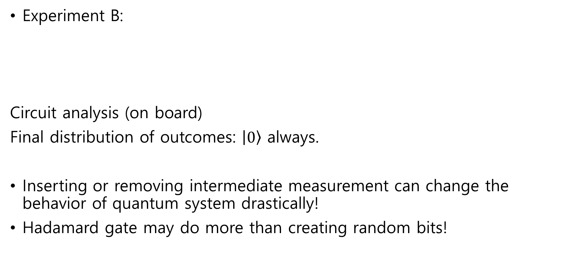


Example: Measurement matters
Experiment B:
Circuit analysis (on board)
Final distribution of outcomes: $\left|0\right\rangle$ always.
Inserting or removing intermediate measurement can change the behavior of quantum system drastically!
Hadamard gate may do more than creating random bits!
$$\left|0\right\rangle$$
$$H$$
$$H$$

Slide 42















Quantum interference (Experiment B)
$$\left|0\right\rangle$$
$$H$$
$$H$$
$$1/\sqrt{2}$$
$$\left|0\right\rangle$$
$$\left|0\right\rangle$$
$$1/\sqrt{2}$$
$$1/\sqrt{2}$$
$$\left|1\right\rangle$$
$$\left|0\right\rangle$$
$$1/\sqrt{2}$$
$$\left|0\right\rangle$$
$$1/\sqrt{2}$$
$$\left|1\right\rangle$$
$$−1/\sqrt{2}$$
$$\left|1\right\rangle$$

Slide 43

Quantum interference (Experiment A)
$$\left|0\right\rangle$$
$$H$$
$$H$$
$$1/\sqrt{2}$$
$$\left|0\right\rangle$$
$$\left|0\right\rangle$$
$$1/\sqrt{2}$$
$$1/\sqrt{2}$$
$$\left|1\right\rangle$$
$$\left|0\right\rangle$$
$$1/\sqrt{2}$$
$$\left|0\right\rangle$$
$$1/\sqrt{2}$$
$$\left|1\right\rangle$$
$$−1/\sqrt{2}$$
$$\left|1\right\rangle$$

Slide 44
Intermediate measurement matters!
Takeaway: measurements destroy superpositions and prevent interference!
In quantum physics, amplitudes can be negative or complex, so that adding up amplitudes becomes 0.
(cf. In classical physics, probabilities are positive, so the events do not disappear!)
Interference is an example of “quantum weirdness” or “spookiness”

Slide 45
Examples
Quantum random number generators
Example about phases
Example about a single intermediate measurement
Example about many measurements

Slide 46
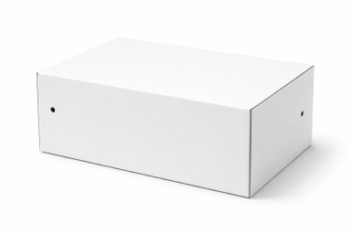
Elitzur-Vaidman Bomb
Slightly advanced
Say we find a suspicious box in this classroom. A note attached:
“A bomb is inside the box. Do not open it, as it will explode! Give A+ to all, otherwise I will active the bomb!”
You do not want to get an automatic A+ for this class as a learner with a thirst for knowledge. You suspect it is a fraud, and wonder if it actually has an active bomb inside. You find two tiny holes in the box.

Slide 47






Elitzur-Vaidman Bomb
Further careful inspection, you reveal:
There are two tiny little holes.
You can emit a photon into one, then it will come out from the other.
The purported bomb is connected to the measurement device; it will measure whether the photon is vertically polarized, and if yes, it triggers the bomb; otherwise it does nothing.
$$\left|φ\right\rangle$$
$$\left|b\right\rangle$$
$$\left|φ\right\rangle$$
$$\left|φ\right\rangle$$
$$b$$

Slide 48

Elitzur-Vaidman Bomb
We want to distinguish two cases:
If there is no bomb, the box does nothing.
If there is a bomb, the box does measure input
If the outcome is $b=0$, nothing happens and you get the leftover state $|0⟩$
If the outcome is $b=1$, the bomb explodes! (You may not care about what the output wire gives you…)
$$\left|φ\right\rangle$$
$$\left|b\right\rangle$$
$$\left|φ\right\rangle$$
$$\left|φ\right\rangle$$
$$b$$

Slide 49





The probing strategy
Classically, you cannot do anything (as long as you are alive)
Using quantum computing?
Take 1:
Analysis is almost the same with the previous example
$R=R_{π/4}$, so that $R\left|0\right\rangle =\left|+\right\rangle , R\left|+\right\rangle =|1⟩$
$$\left|0\right\rangle$$
$$R$$
$$BOX$$
$$R$$

Slide 50
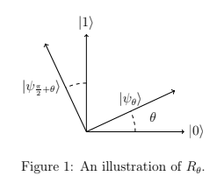

One more gate
Quantum rotation gate $R_{θ}=\left(\begin{matrix}\cos{θ} & −\sin{θ} \\ \sin{θ} & \cos{θ}\end{matrix}\right)$
$R_{θ}\left|0\right\rangle =$ ( do on board )
$R_{θ}\left|1\right\rangle =$ ( do on board )
Define $\left|ψ_{θ}\right\rangle =\cos{θ}\left|0\right\rangle +\sin{θ}|1⟩$
Check that $R_{θ}|ψ_{ρ}⟩=|ψ_{ρ+θ}⟩$

Slide 51


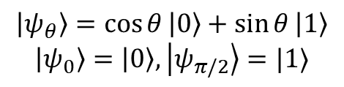








The probing strategy
$$\left|ψ_{θ}\right\rangle =\cos{θ}\left|0\right\rangle +\sin{θ}\left|1\right\rangle$$
$$\left|ψ_{0}\right\rangle =\left|0\right\rangle ,\left|ψ_{π/2}\right\rangle =|1⟩$$
Choose $θ=\frac{π}{2N}$ for large integer $N$. Prepare $\left|φ\right\rangle =\left|ψ_{0}\right\rangle =|0⟩$
Repeat $N$ times: Apply $R_{θ}$; feed $\left|φ\right\rangle$ into the box and get the outcome $\left|φ\right\rangle$
$$\left|0\right\rangle$$
$$R_{θ}$$
$$BOX$$
$$R_{θ}$$
$$BOX$$
$$R_{θ}$$
$$BOX$$
$$R_{θ}$$
$$BOX$$

Slide 52









The probing strategy
$$\left|0\right\rangle$$
$$R_{θ}$$
$$BOX$$
$$R_{θ}$$
$$BOX$$
$$R_{θ}$$
$$BOX$$
$$R_{θ}$$
$$BOX$$
Analysis is on board
Conclusion: We can detect the active bomb, with a prob 1/N of death.

Slide 53
Summary
Qubit
Measurement
Unitary
Quantum random number generators
Quantum interference
Bomb tester

